Slide 1
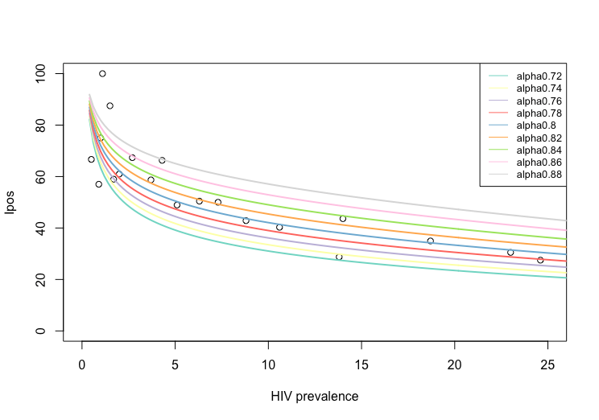
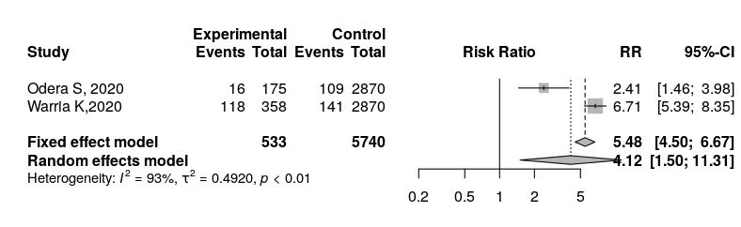
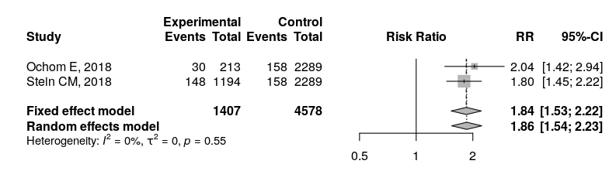
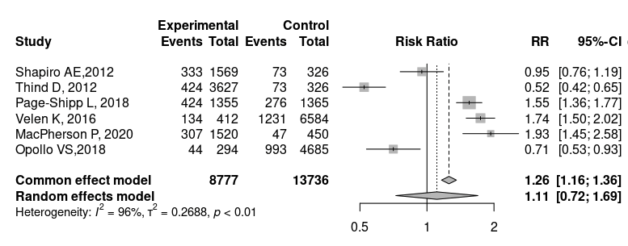
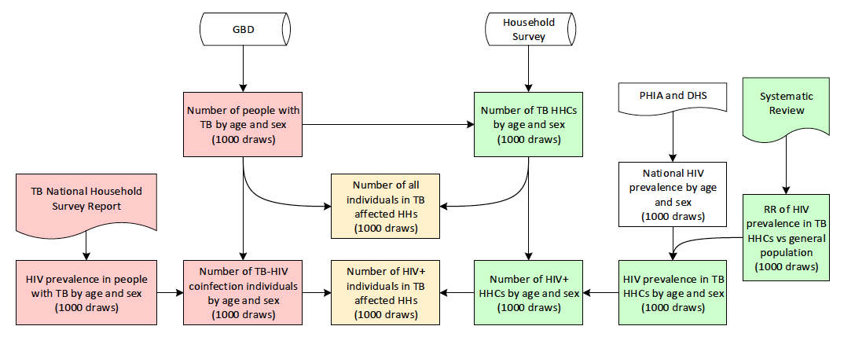
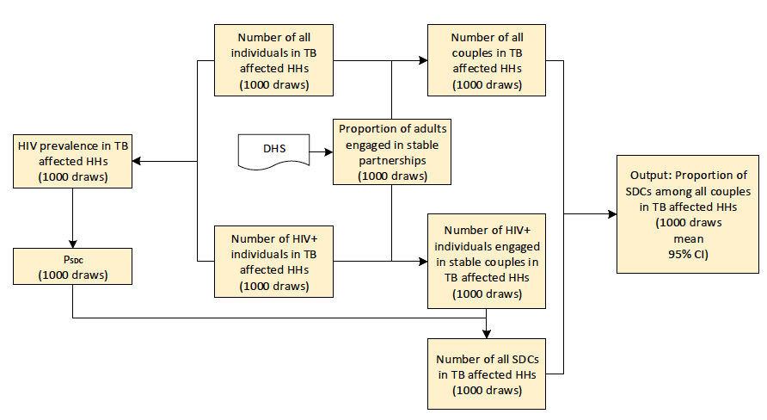
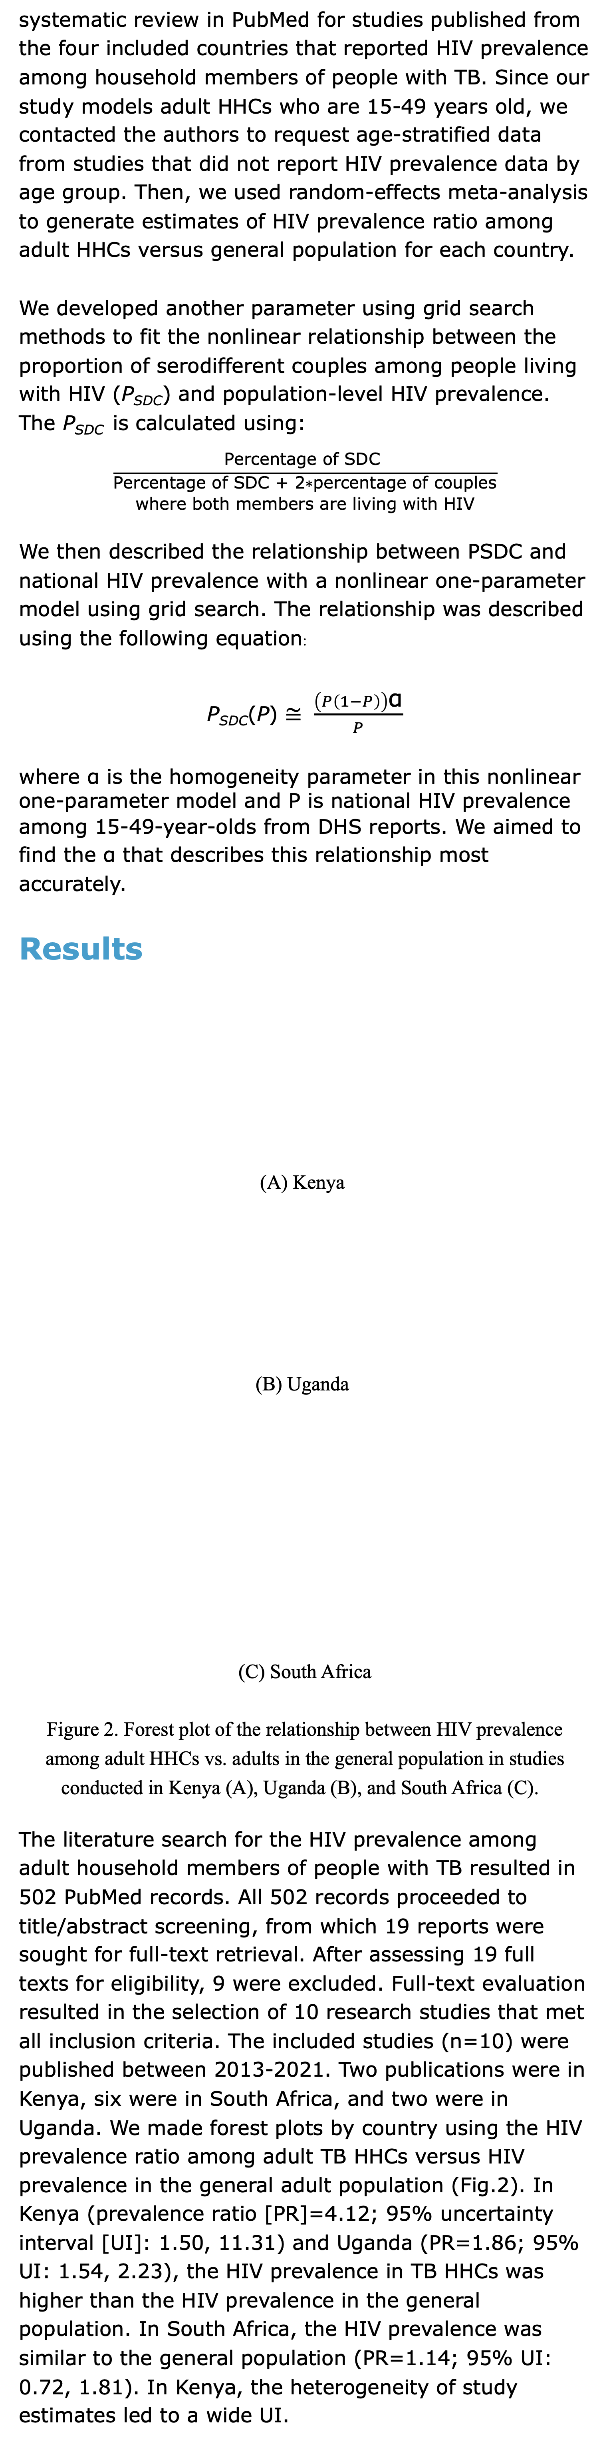
Modeled estimates of HIV-serodifferent couples in tuberculosis-affected households in sub-Saharan Africa M. Zhang , A. Tseng , G. Anguzu , R. Barnabas , L. Davis , A. Mujugira , A. Flaxman , J. Ross
Background
Human immunodeficiency virus (HIV) and tuberculosis (TB) are linked epidemics, with TB as the leading cause of death among persons living with HIV globally. Integration of HIV and TB care into “one-stop shop” models where patients can access care and prevention for HIV and TB concurrently have been central to global strategies to reduce TB and HIV morbidity and mortality.
Household TB contact (HHC) evaluation involves finding the HHCs of persons with TB, providing screening for active TB disease, and initiating TB preventive treatment (TPT) in persons without symptoms of active TB. HIV prevalence among HHC is frequently higher than in the general population. However, as HIV incidence may also be elevated among HHC, HHC programs may also be a valuable opportunity to integrate HIV prevention counseling and pre-exposure prophylaxis (PrEP) initiation for individuals who test negative for HIV and could benefit from PrEP.
HIV-serodifferent couples (SDCs) are a priority population for PrEP under WHO PrEP guidelines. With the scale-up of TB HHC evaluations, there is an opportunity to increase the reach of HHC efforts through integration of HIV testing among SDCs in TB-affected households. Thus, TB HHC evaluation may be an excellent opportunity to improve linkage to HIV care and PrEP among SDCs and prevent HIV acquisition.
In this study, we estimate the yield of identifying SDCs through TB HHC investigation versus population screening in modeled scenarios in four TB-HIV high-burden countries (Ethiopia, Kenya, South Africa, and Uganda).
Methods
Study Design
This model-based analysis incorporated modeled estimates with parameters from the literature to generate estimates of the prevalence of SDCs among TB-affected households in Ethiopia, Kenya, South Africa, and Uganda. We integrated data from population-based household surveys with age-, sex-, and country-specific HIV and TB incidence estimates to model the population and household size, within-household sexual partnerships, and HIV status of HHCs of persons with TB in each country. Then, we compared these estimates of the prevalence of SDCs identified through community screening.
(A)
(B)
Figure 1. Flow diagrams of mathematical models used in this study. (A) Flow-chart depicting the process of obtaining the TB and HIV-TB coinfection situation in TB affected households. (B) Flow-chart depicting the process of generating the proportion of SDCs using outputs from (A).
Parameter Development
For the first key model parameter, we conducted a
systematic review in PubMed for studies published from the four included countries that reported HIV prevalence among household members of people with TB. Since our study models adult HHCs who are 15-49 years old, we contacted the authors to request age-stratified data from studies that did not report HIV prevalence data by age group. Then, we used random-effects meta-analysis to generate estimates of HIV prevalence ratio among adult HHCs versus general population for each country.
We developed another parameter using grid search methods to fit the nonlinear relationship between the proportion of serodifferent couples among people living with HIV (P_{SDC}) and population-level HIV prevalence. The P_{SDC} is calculated using:
$$\frac{\text{Percentage} \text{of} \text{SDC} }{\begin{aligned}\text{Percentage} \text{of} \text{SDC}\text{ + 2∗}\text{percentage} \text{of} \text{couples} \\ \text{where} \text{both} \text{members} \text{are} \text{living} \text{with} \text{HIV} \end{aligned}}$$
We then described the relationship between PSDC and national HIV prevalence with a nonlinear one-parameter model using grid search. The relationship was described using the following equation:
P_{SDC}(P) $≅ \frac{\left(P\left(1−P\right)\right)\text{α}}{P}$
where α is the homogeneity parameter in this nonlinear one-parameter model and P is national HIV prevalence
among 15-49-year-olds from DHS reports. We aimed to find the α that describes this relationship most accurately.
Results
(A) Kenya
(B) Uganda
(C) South Africa
Figure 2. Forest plot of the relationship between HIV prevalence among adult HHCs vs. adults in the general population in studies conducted in Kenya (A), Uganda (B), and South Africa (C).
The literature search for the HIV prevalence among adult household members of people with TB resulted in 502 PubMed records. All 502 records proceeded to title/abstract screening, from which 19 reports were sought for full-text retrieval. After assessing 19 full texts for eligibility, 9 were excluded. Full-text evaluation resulted in the selection of 10 research studies that met all inclusion criteria. The included studies (n=10) were published between 2013-2021. Two publications were in Kenya, six were in South Africa, and two were in Uganda. We made forest plots by country using the HIV prevalence ratio among adult TB HHCs versus HIV prevalence in the general adult population (Fig.2). In Kenya (prevalence ratio [PR]=4.12; 95% uncertainty interval [UI]: 1.50, 11.31) and Uganda (PR=1.86; 95% UI: 1.54, 2.23), the HIV prevalence in TB HHCs was higher than the HIV prevalence in the general population. In South Africa, the HIV prevalence was similar to the general population (PR=1.14; 95% UI: 0.72, 1.81). In Kenya, the heterogeneity of study estimates led to a wide UI.
Figure 3. Simulated relationship between PSDC and HIV prevalence using α between 0.7 and 0.9
In the process of describing the relationship between PSDC and HIV prevalence (P), we found the best homogeneity parameter, α. As shown in Fig. 3, each data point represents 1 𝑃𝑆𝐷𝐶−𝑃 pair extracted from DHS reports. In this step, we found that 𝛼 = 0.82 minimizes the least square.
Table 1. The HIV prevalence and the SDCs in TB affected households
We estimated the HIV prevalence among adults aged 15-49 living in TB-affected households to be higher than in the general population in all 4 countries. The proportion of serodifferent couples among all couples in TB-affected households was also higher than in the general population in 4 countries.
Table 2. HIV acquisitions averted through PrEP
Finally, we estimated that up to 1,836 (95% UI: 1,304-2,358) HIV acquisitions in South Africa could be prevented annually by PrEP use in serodifferent couples in TB-affected households, 927 (95% UI: 413-1,464) in Kenya, 709 (95% UI: 523-893) in Uganda, and 415 (95% UI: 304-531) in Ethiopia.
Conclusions
We estimate that couples in TB-affected households are more likely to be serodifferent than couples in the general population in TB-HIV highburden settings. Offering PrEP during household TB contact evaluation may prevent a substantial number of HIV acquisitions.
Country | HIV prevalence among TB affected HHs | HIV prevalence in population | P of SDC in TB affected HHs | P of SDC in population
Kenya | 19.40 (6.03-34.83) | 4.5 (4.1-4.9) | 15.89 (7.10-22.67) | 5.7 (4.4-7.0)
Uganda | 15.32 (13.47-17.16) | 6.0 (5.7-6.3) | 13.65 (12.43-14.85) | 6.0
Ethiopia | 2.82 (2.59-3.03) | 0.9 (0.8-1.0) | 3.85 (3.59-4.14) | 0.8 (0.6-1.0)
South Africa | 31.74 (23.98-39.46) | 20.6 (19.9-21.3) | 20.68 (17.97-22.82) | 15.7 (12.2 – 19.2)
 | Percentage of partnerships would be eligible for PrEP because the partner living with HIV was not virally suppressed
 | 100% | 75% | 50% | 25%
Kenya | 927 (413 - 1464) | 695 (310 - 1098) | 464 (207 - 732) | 232 (103 - 366)
Uganda | 709 (523 - 893) | 532 (392 - 670) | 355 (262 - 447) | 177 (131 - 223)
Ethiopia | 415 (304 - 531) | 311 (228 - 398) | 208 (152 - 266) | 104 (76 - 133)
South Africa | 1836 (1304 - 2358) | 1377 (978 - 1769) | 918 (652 - 1179) | 459 (326 - 590)

